Slide 1

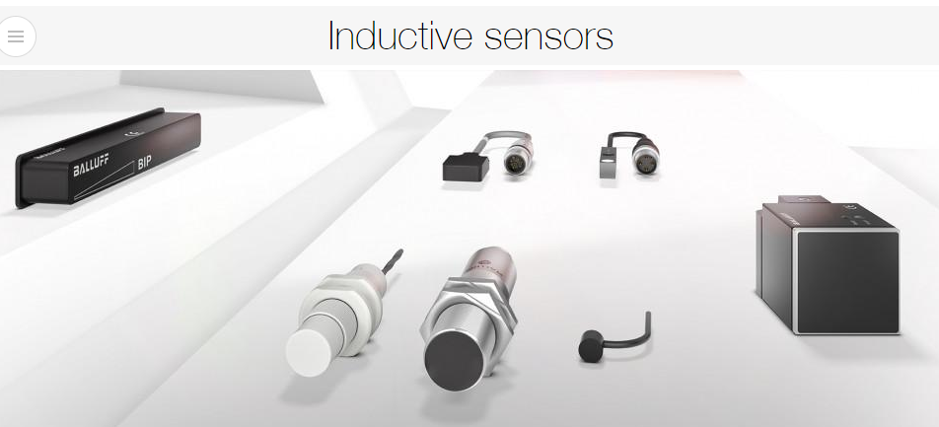
Inductive Proximity Sensors
- Highest quality and accuracy for automation :
Automation without inductive sensors can hardly be imagined. Wear-resistant, reliable non-contact position detection of metallic objects is required wherever automation is used, whether in mechanical engineering, electronics production, automotive, food, or plastics industries.
Balluff offers a wide range of inductive sensors with diverse designs for nearly any application: from standard sensors to sensors with increased switching distance, hygienic sensors, high-pressure sensors, ex-zone sensors for hazardous areas, and factor 1 sensors.
Aided by inductive sensors from Balluff, you can automate, monitor, and control processes and conditions at the highest quality, even in extreme environments.

Slide 2
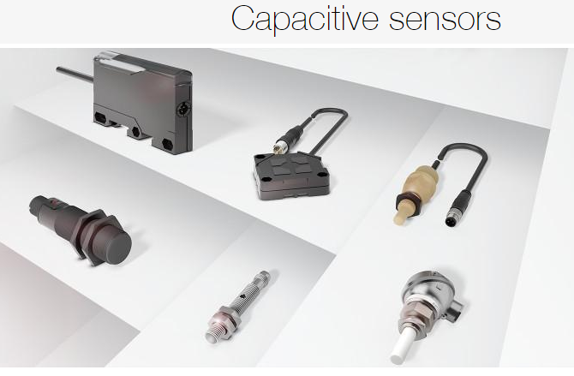
Capacitive Proximity Sensors
- Reliably detect objects and fill levels :
Capacitive sensors detect objects and the fill level of all non-conducting materials, liquids, pellets, and powders directly or through a container wall.
The patented Smart Level technology of the sensors compensates for moisture, foam and adhesion of all sorts – even through glass and plastic walls up to 10 mm thick. This makes the sensors ideal as fill level sensors for conductive media. And guarantee you high application security.
Our sensors are available in diverse designs, even especially small ones. As adhesive sensors, they fit flexibly to the housing shape and are easily removable.

Slide 3
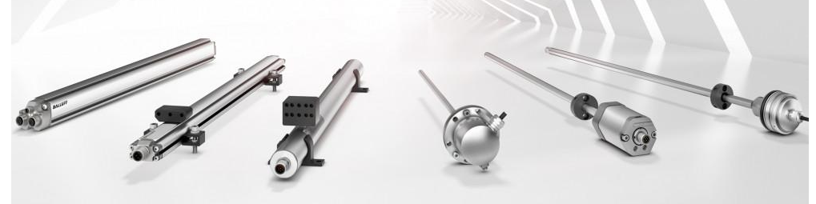
Magnetostrictive Sensors ( BTL )
- Maximum system availability and safety, even in severe environments .
Magnetostrictive position measurement systems come into use generally where high reliability and precision are demanded in position and speed measurement.
Over long distances, our contact-free and absolute measuring systems are suitable for all industry-standard interfaces and for a wide range of applications. Even under extreme surrounding conditions, they guarantee a high machine and system availability.

Slide 4

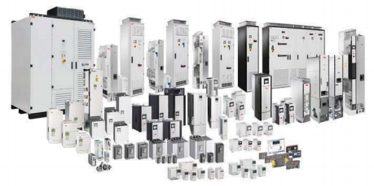
ABB Drives
It’s one of the best energy saving solutions .
You base your business on efficiency and performance , Our drives are made with all this in mind, empowering productivity and efficiency. They provide flexibility to help you optimize your processes and control, and reliable for less downtime.
Our offering includes low voltage Ac drives , They are used across all industries and applications.
The ABB low voltage AC drives product range , from 0.18 to 5600 KW , it is the widest power range in the market .
Some types : { ASC580 general purpose drives (0.75:250)kw , ACS355 machinery drives (0.37:22)kw , ACS150 micro drive (0.37:4)kw , ACS880 industrial drive (0.75:2800)kw , ACS355 for solar pumps (0.037:18.5)kw , ACSM1 for solar pumps (0.37:45)kw extended to 250kw , ACQ for water and wastewater (0.75:500)kw , Drives Electric Panel , Multi Pump Panels } .

Slide 5
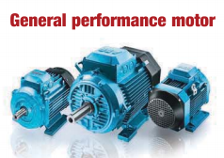
ABB General Performance Motor
Can be used in a wide range of industrial applications .
These motors are especially suitable for pumps and fans , as well as for gearboxes , conveyors , general machinery and other applications.
Simple robust , design and Europe manufacture
Cast iron M2BAX – IEC frame sizes 71 to 355 – IE3
Aluminum M2AA – IEC frame sizes 56 to 250 – IE2

Slide 6
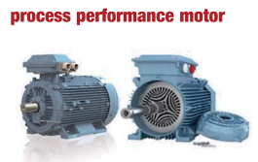
ABB Process Performance Motors
Provide great flexibility for customer specific solutions and can be individually designed to meet the exact demands of the application.
Best solution suitable for your need.
Efficiency classes from IE2 up to IE5.
Wide range of variant codes for all industrial applications
Cast iron M3BP – IEC frame sizes 71 to 450 – IE2 , IE3.
Aluminum M2AA – IEC frame sizes 63 to 280 – IE2 , IE3.

Slide 7
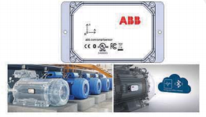
ABB Smart Sensor
- Smart sensor is a new product made by ABB.
Smart sensor is the condition monitoring solution for motors whether ABB or non ABB motor , it converts traditional motors into smart , wirelessly connected devices .
Smart sensor can monitor :
1- energy consumption. 2- Rotor health.
3- Temperature. 4- air gap eccentricity.
5-cooling condition. 6-Bearing condition.
7- overall vibration.
- Advantages of smart sensor :
1- simple to install and use.
2- no wiring or machining is needed.
3- data transfer via built in wireless bluetooth low energy.
4- data communications use industry standard encryption protocols.
5- all data is securely stored in the cloud.
using smart sensor , you can avoid cost downtime , productivity is increased and motor life time is extended.

Slide 8

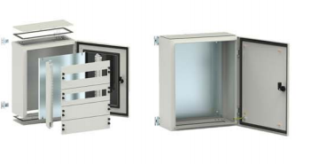
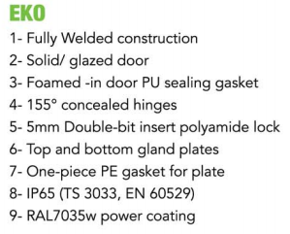
Wall Mounted Enclosures

Slide 9
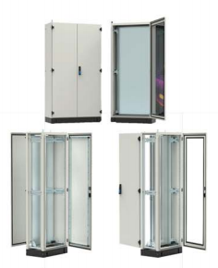
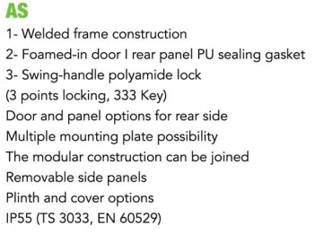
Floor Standing Enclosures

Slide 10
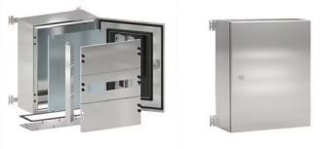
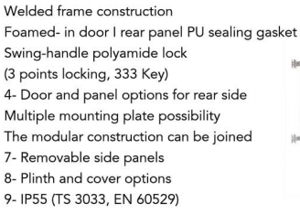
Stainless Steel Enclosures

Slide 11

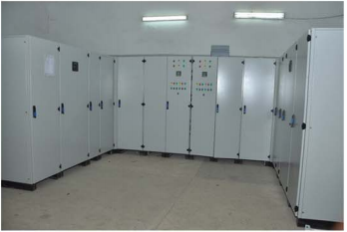
Certified Qualified Panel Builder
Customized Main Distribution Panel for very narrow space

Slide 12
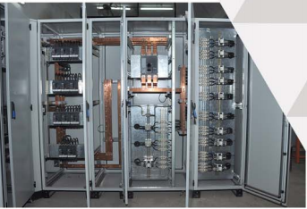
Power factor correction panel

Slide 13
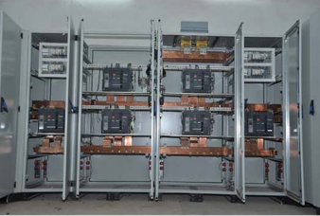
Under construction customized ATS

Slide 14

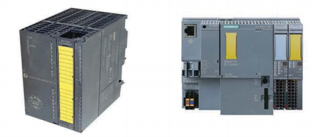
- Fail safe simatic controllers :
Fail safe plcs are used to guarantee the functional safety of machines or plants .

Slide 15
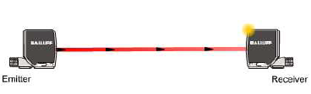
Thru-Beam Sensors
High repeat accuracy and stability.
Insensitive to contamination.
Detection independent of :
- Color - Luster
- Surface texture
. Long range (up to 100m).
. Strong emitter to receiver light path.
# 2-part system :
. Mounting restrictions.
. Higher costs (wiring, powering).

Slide 16
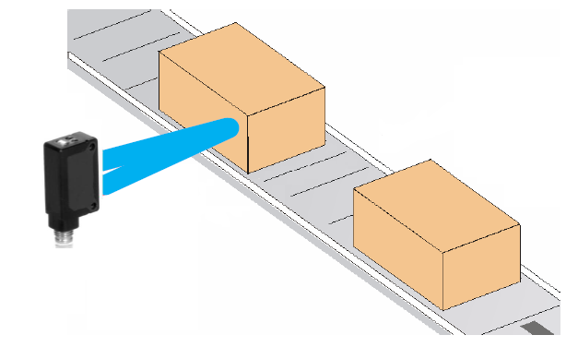
Diffuse Sensors
Emitter and receiver in a single housing.
Sensor uses the target to reflect light back to itself.
- This eliminates the need for a secondary device such as a reflector.
- Light diffuses off target and is then detected by the receiver.
. Targets can vary greatly in color and this will directly affect the range of the sensor.

Slide 17

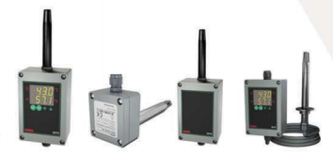
Hygrostat & Thermostat
Sensor input for temperatre & humidity 0 – 20mA .
Support functions of (heating/cooling control),(drying/moistening control),(fan timer control),(rotator timer control).
On-off control for two set values.
Control outputs are (1 really (NO) for temperature , humidity & fan) & ( 2 really (NO) for rotator ).

Slide 18
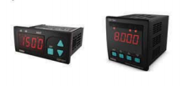
Digital Potentiometer
Adjustable universal analog output for accurate control of motor’s speed universal output (0/4-20mA . 0-10 V ) ,
“soft-on” & “soft-off” functions
- RS-485 communication .

Slide 19
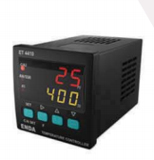
Special Purpose Controllers
Double set point can be selected.
Selectable thermocouple types.
PID control function with accurate self tuning.
Selectable analog , SSR , relay or motorized valve control output.
Selectable 0-20mA and 4-20mA retransmission output.
Selectable heating and cooling control.

